Slide 1

SAP UI5 and Fiori Training with OData on BAS and WebIDE
LIVE
Anubhav Oberoy
https://www.anubhavtrainings.com
Follow excellence with sheer passion
NO COPY PASTE

Slide 2





Pola
Solution Architect
Kevan
Sam
UX Designer
Fresher
Stevia
Nolan
Technical Consultant
Application Developer
You Can!
Anyone can learn SAP UI5 with Anubhav
Notes:
Source of the image:
https://pixabay.com/photos/model-businessman-corporate-2911332/
https://pixabay.com/photos/beautiful-business-woman-modern-2910260/
https://pixabay.com/illustrations/business-woman-isolated-4675105/
https://pixabay.com/photos/man-portrait-business-chinese-537136/
https://pixabay.com/photos/business-meeting-people-corporate-695489/

Slide 3
01
Fundamentals
Learn the core concepts of HTML5, CSS, JS, jQuery Setup BAS and WebIDE
Steps
Learn Entire UI5 and Fiori App development with OData in four simple phases
02
UI5 Framework
Understand SAP UI5 framework and SDK and build using MVC architecture.
03
Fiori UX Development
Create Fiori Applications using Mobile library with latest concepts
04
OData Development
Build Services in Gateway system and expose ERP Data to Fiori Apps

Slide 4
Our Agenda Today
Start
Create a Simple App
Setup Business App Studio
BAS
Get Started with Development tool
Create Project
Commence
Understand workspace in BAS and create one for us

Slide 5
MVC
Develop
Create your First MVC architecture based UI5 project
Show the Magic
Test
Run the First Application and Show a picture
Finish
You made it!

Slide 6
What is UI5
UI5 is a framework to build responsive web application which runs on any platform, any browser and any OS.
Responsive – App which can adapt itself according to different device
Framework – It’s a collection of Libraries
Library – is a collection of classes
Class – Collection of methods, attributes, events etc.

Slide 7
Developing an App
BAS or WebIDE
Web file – html – Load the framework (bootstrap)
MVC Framework – Model, View, Controller.

Slide 8
What will be the duration of the training, and pre-requisite?
The duration of the course is 40 Hours, and there is no pre-requisite other than basic programming skills.
The timing does not suite me so can I go for video mode?
Yes, you can opt for video mode training of our most recent batch and ask your questions over the email. This option also applies those who want fast-track learning and not want to be with existing batch.
What tool do I need to learn and where do I get?
We will build all the apps on Business application Studio and SAP WebIDE tool. In our next class we will see how to install the tool in your system or get cloud access. WebIDE (PE) absolutely free for single developer.
What about server to practice OData?
We need OData server only in last 10 sessions for which we will guide you in session no 29, where, how to get the OData server and also may be you can use co. server, all the required components will be explained.
Will you cover real time scenarios?
Yes, we will learn end to end process of Developing the Fiori apps and finally connecting with real SAP data, deploy and deliver apps to Production system.

Slide 9
I am new to SAP UI5, can I learn?
Yes, this course is designed in a way that a fresher can learn because we will cover all basics like HTML, CSS, JavaScript and jQuery
We DO NOT NEED Java to learn the course at all.
If I miss a class how to refer?
Each class will be recorded and you can watch is once done. So even you miss or not miss the class, you always can watch class recordings.
Process to enrol for this course.
Please email us on contact@anubhavtrainings.com
For More Please visit
www.anubhavtrainings.com/faqs

Slide 10

Thank You
Training | Development | Consulting
The starting point of all achievement is desire. Keep this constantly in mind. Weak desires bring weak results, just like as a small amount of fire makes a small amount of heat.

Slide 11
SAP UI5
SAP UI5 is a framework which is used to develop Responsive web applications to run on any platform, any browser and any OS.
Responsive – App which can adapt itself according the different devices
Framework – It’s a collection of Libraries
Library – Collection of classes
Class – Collection of methods, Attributes, Events

Slide 12
Developing an App
BAS or WebIDE
Web file – html – Load the framework (bootstrap)
MVC Framework – Model. View. Controller.

Slide 13
*Free
How to setup our development tool
Business Application Studio*
SAP WebIDE - 80%
It is a tool available in cloud as a service
No installation required in local machine
Multi-cloud development tool (Fiori, CAPM, HANAXSA, Java, Node)
Is the future tool
Recommend – evolving
Built as a copy of VSCode
WebIDE Personal Edition*
WebIDE Cloud
Install in your local computer (Java 1.8)
Runs on browser
Designed for single developer locally
Offline and projects in your local computer
Trial purpose, learning
https://www.sapstore.com/solutions/60009/SAP-Web-IDE
Eclipse – 9 year

Slide 14
Setup BAS
Go to https://cloudplatform.sap.com
Create free trial account
Launch your cloud platform trial cockpit - https://account.hanatrial.ondemand.com/cockpit
On main screen you will see BAS
Click and Create Dev Space
Choose SAP Fiori as dev space type

Slide 15
WebIDE Personal Edition
Pre-requisite
You must have java 1.8 any java version above 1.8 will not work
Cmd➔java –version Click here to download JDK1.8
You need to have Winrar Software
Chrome browser
Setup the WebIDE
Download the package from internet https://tools.hana.ondemand.com
Once we download zip file, copy from downloads folder to c:\myWebide
Go inside c:\mywebide and right click on zip file, choose Extract here (5-10min)
Go inside and file a eclipse folder which has orion.exe file
Right click on it and go to properties and choose run as administrator always
Apply and close properties, Optionally create a shortcut on desktop
Run Orion.exe (server), DO NOT CLOSE BLACK WINDOW
Type url http://localhost:8080/webide/index.html
Create an account and login

Slide 16
Process for support
Check the video – see if done a case sensitive, folder structure…
Download anubhav’s code and import and test
Compare the code side by side
Check the console…
Upload the zip/tar file to google drive, share with a public link on anubhav.abap@gmail.com
Exercise:
Setup your development tool ☺

Slide 17
Client-server Architecture
Form submit
Http Plain object
Ajax call
Header + Body(optional)
Client
Browser
User
Server
request
Port
Java, NodeJS,
ABAP
response
processing
Header + Body
Header
Type: GET, POST,PUT,DELETE
Content-type:format of the data
…
GET –Read Data
POST- Create new data
PUT- Update Data
DELETE – Delete data
CRUD

Slide 18
HTML?
HTML stands for HyperText Markup Language, It is used to design static web content. HTML is developed and designed by org named W3C – World Wide Web Consortium
All the browsers are members of W3C.
History
Year | Version
1991 | HTML
1993 | HTML 2.0
1997 | XHTML
1999 | HTML 4
2014 | HTML 5

Slide 19
Difference b/w HTML and HTML5?
HTML5 is merely latest version of HTML
Declaration of HTML document was simplified
It is not mandatory to close certain tags anymore e.g. input, img..
We have different kinds of input controls
We can add validations which carries out directly on browser
We have direct support for audio and video tags
Its faster and provide support for headless browsers

Slide 20
Difference between UI5 and HTML5?
UI5 is a framework and HTML5 is a markup
UI5 is managed by SAP but HTML5 is managed by W3C

Slide 21
Funda Fox
HTML page contains a header and a body, the body is what user sees.
HTML is a tree data structure
Each HTML element is called tag, we will have starting and ending tag
Syntax
<tagName prop=“val”>Content</tagName>
F12 – Browser Dev Tools, Developer toolbar
HTML is not a programming language, it’s a markup
When we test HTML page in browser, the generated TREE data structure is known as DOM – Document Object Model
Documentation:
https://www.w3schools.com/

Slide 22
Super Funda fox
There is nothing Like Magic!

Slide 23
Exercise
Design a list control with below topic names
UI5 and Fiori
ABAP on HANA SAP Analytics Cloud
SAP CPI
Every item must be a link
When we click on the link, it should navigate to the youtube channel video
https://www.youtube.com/c/AnubhavOberoy/videos

Slide 24
Block level elements
These tags are used to group elements on UI, they don’t have their own footprint on screen.
Div – division tag – this tag will be used to create a block, it always starts from new line. It is recommend practice to use a class property along with this tag to provide classification.
Span – Called inline element and used for the purpose of putting elements in same line.

Slide 25
What is CSS and Why?
HTML can only generate static content w/o coloring, formatting, borders, beautification. CSS stands for cascading style sheet and used to add formatting to our static content.
Before CSS we used to use tags as below
<p>I love India</p>
<p>I <font name=“”><color name=“red”><b>Love</b></font></color> <font name=“”><color name=“red”><b>India</b></font></color> </p>
Three ways we can apply CSS
Inline CSS – Along with HTML Element, we use style=“prop:val;prop:val..” – high maint.
Internal CSS – At the page level
External CSS – CSS is created as a separate file and linked to the page

Slide 26
Internal CSS
Is applied at page level
We will use a <style> tag inside which we write style code
Syntax
selector {
prop:val;
prop:val;
prop:val;
….
}
Selector – target – element(s)
TagBased
.ClassName
#Id

Slide 27
Responsive Web Design
A web design which adapts itself according the devices.
CSS Box Model
margin
padding
padding
HTML Element
HTML Element

Slide 28
Exercise
Create a music table, add styling to add borders around cells. We should get a table like experience with horizontal and vertical separators.

Slide 29
Pseudo Classes
A special styling mechanism which applies styles based on different conditions. E.g. focus, nth child, hover.
Selector:pesudoclass{
….
}

Slide 30
JS – Java Script
Java script is programming language
It is an asynchronous non-blocking IO language
Its very light weight
Browser directly understand JS
This is the most used programming language on this planet
Funda Fox
JS is case sensitive
= is assignment operator and === is comparison operator which compares the values and data types
When we code JS, we follow naming camel-case conversion. First letter of a work is small and next consecutive word’s first letter is always caps
iloveindia → iLoveIndia
wearelearningjavascript → weAreLearningJavaScript
itwasatoughday → itWasAToughDay

Slide 31
Funda Fox
We have 2 types of functions in JS
Anonymous Function – a function w/o name
function (p1,p2){
--coda
}
Named Function
function functionNameIsHere(p1,p2){
--coda
}
Symbols are having special meaning – ( ) – parenthesis, {} – curly braces, [ ] – bracket
JS also has 2 very poweful built-in variables
1. document – it is the object of DOM. We can traverse the tree using this object. It provides ready-made methods. E.g. getElementsByTagName, getElementsByClassName, getElementById
2. window – it is the object of browser window.

Slide 32
How to apply JS
There are 3 ways
Inline JS – is applied at element level, no-reuse. https://www.w3schools.com/jsref/dom_obj_event.asp
<tagname eventname=“coda”></tagname>
Internal JS – is applied at the page level inside a special tag <script> tag. We will write multiple functions.
External JS – We move our code to an external file with extension .js or .ts and reuse the same using <script src=“”>
There are 4 types of output function in JS
window.alert
document.write
console.log()
HtmlElement.innerText

Slide 33
Funda Fox
There are 2 types of JS
Client-side JS – when code runs on browser, This training only focus on client-side JS.
Server-side JS – when the code runs on a webserver, e.g. NodeJS, XSJS
Every statement in JS ends with semi-colon
Exercise:
Extend our app to validate user and password, if both are same as your name, show a page to user displaying “login success!”.
Console is our best friend !

Slide 34
Debugging Shortcuts
We can directly debug in browser and shortcuts are
F10 – step over – F6
F11 – Step inside – F5
Shift + F11 – Step out – F7
F8 – continue till next BP – F8
F5 – Whole page refresh

Slide 35
Async Nature, why needed?
<Text>

Slide 36
Sequence
User
Screen
Server
Database

Slide 37
Exercise
Practice concept of Non-blocking IO
Watch promise video
https://www.youtube.com/watch?v=zY6gnfxgb9I
Use cases of JS
Used to validate data
It is used for entire web development
JS can show output to user
JS can change CSS at runtime
JS can add dynamic UI elements
Add manipulation logic using JS
Invoke Server requests, handle response using call backs
Open standard and all browsers supports JS

Slide 38
Array and Objects
Syntax for Array
var aItems = [item0, item1,….]
Syntax for object
var oObjName = { “prop”: value,
“prop”: value,
“prop”: value }
Value1 | Value2 | Value3 | ….
Java Script Object Notation – JSON
You can validate json using https://jsonlint.com

Slide 39
<Title>
{
//this is an entityset of type object (single)
"empStructure": {
"empNo": 100,
"empName": "Latika Roongta",
"salary": 9000,
"currency": "EUR"
}
}
Entityset
Elements or properties

Slide 40
Exercise
Design a json for a book store with following entities
Books
Students
Topics

Slide 41
jQuery
jQuery is a java script library which is
Free
Used by top software companies like google, Netflix, ms
Light weight JS library
Available on internet
Purpose is to write less and do more
Industry standard
Syntax
$(selector).action();
Selectors:
tagName
.classname
#id
$ - I want to use jquery

Slide 42
CDN – Content Delivery/Distribution N/w
All load is on one server
Performance issue
IP compliance
India
Reusable JS
Mumbai
USA
Japan

Slide 43
Exercise
Create a button and a image
When image is hover, nothing happens
When we click on button, we dynamically attach a hover event to image
After that if we hover image the size should increase

Slide 44
What is SAP UI5?
SAP UI5 is a framework, It consist of libraries
Libraries – Collection of classes
Class – Collection of properties, methods, events and aggregations
The sole purpose is to develop Responsive web applications. The UI5 framework is built on top of open standards like HTML5, CSS, JS, and jQuery. We use MVC architecture to create applications using SAPUI5.
BAS
App
SAP UI5 Design Time Component
SAPUI5 Runtime Component
HTML+CSS+JS
sap.m
sap.ui.comp
sap.ui.table
sap.ui.layout
Renderer
sap.ui.core
sap.ui.unified
sap.ui.core.mvc
HTML5
CSS
JS
jQuery

Slide 45
How do I know?
Where can I learn more on UI5?
Do you give books?
How I can check how many libraries are there?
How to check which prop, methods are available in each class?
How to check relation of these classes?
What are all best-practices?
Can I see some sample apps?
SAP UI5 SDK
Software Development Kit

Slide 46
Basic Idea of OOPS
Parent, Mother, Base Class
Input Passenger
Plane simple
+ name
+ Country
+ PassportNo
+ Age
update() register()
booking()
+ height
+ width
+ color
+ content
Load()
Fly()
Engine, Wings…
+ fuel consumption
+milage
+hoursepower
Start()
Stop()
extends
extends
Child, Daughter, Sub Class
Child, Daughter, Sub Class
Passenger Plane
Cargo Plane
Association
Aggregation – Empty Rhombus
Lose Coupling, Both objects can function independently, Good to have relation
Composition – Filled Rhombus
Tight coupling, Both objects cannot function w/o each other, MUST have relationship
+ no of seats
Bookseats()
+ storage_cap
bookstorage()

Slide 47
Control Hierarchy
sap.ui.base.ManagedObject
Syntax to create object
var oName = new libraryName.ControlName({
prop: val,…
});
sap.ui.core.Element
sap.ui.core.Control
sap.m.Button
sap.m.InputBase
Sap.ui.view
sap.m.Table
sap.m.Column
sap.m.Input

Slide 48
Funda Fox
1. Whenever we see a control, and if we are unable to find a property, association, event or function in that class, check its parent class.

Slide 49
Access is denied for BAS
Try to run the SAP BTP in Incognito window
Check for availability of BAS in entitlements in Service assignment on global account
Go to Subscriptions inside Sub Account and check if you are subscribed to BAS
Go to SAP BTP Cockpit and check IDP Configuration and see if the role is assigned for your email id
Go to Security section in sub-account and check if role collection is present and assign the role
Re-create a another sub-account in EU-Frankfurt and subscribe Bas on same.

Slide 50
MVC Architecture
<event>
Processing
Controller
eventHandler
<notifies>
<done>
<modifies>
I/O
View
Data binding
Data
Models

Slide 51
Types
View Types
XML – 98%
JS – 2%
JSON – 0%
HTML – 0%
Model Types
JSON – 100%
XML
Resource – 100%
OData Model – 95%
Controller Types – Always JS

Slide 52
Skeleton of a controller
Skeleton of a ANY JS file in SAP UI5 – Considered as a CLASS
sap.ui.define( [ “dependencies”, “dep2”, “dep3” ] ,
function(oD1,oD2,oD3){
---
}
);
Syntax for a Controller – Special class which inherits from standard SAP Module called sap/ui/core/mvc/Controller
sap.ui.define( [ “sap/ui/core/mvc/Controller” ] ,
function(Controller){
return Controller.extend(“address of controller”, {
-----
});
}
);
Module

Slide 53
Exercise
Design your first MVC app which has to display a view with
An input field
And a button
Initially things are difficult
In the middle they are messy
At the end they are beautiful
Minions
Click
Minions

Slide 54
Funda Fox
For every Control if there is a property, we will have setter and getter methods for that property. For example, if there is a enabled property, we will have setEnabled and getEnabled methods.
To access the methods and properties of a UI Control, We cannot use the document object which is a plain HTML element object.
To obtain UI5 element object, we need to first get Application object,
sap.ui.getCore()
On top of App object, we can get UI5 element object and finally
byId(“just pass ID”)
we can call any methods of UI5
4. For every event in UI5, we have attachEvent, detachEvent, fireEvent methods as well, which can be used to link, delink and trigger event programmatically.
5. When we use JS view, inside the event handler, this pointer will point to the current control object not the class (controller) object. In order to force this pointer to work like our Controller object, we need to pass it explicitly. This ONLY applies in JS View.
6. Just now you showed getting view object from controller, this.getView(), Using this view object also can I get my control objects? Just to avoid sap.ui.getCore() – You can but in XML View
7. When we use XML views, the ID of the control will be viewId--controlId

Slide 55
Under the Hood
index
UI5 Framework
1
View
getControllerName: function(){
return “address of our controller”;
}
getContent: function(oController){
…..
return ControlObjects;
}
2
3
Browser
8
6
Renderer
7
Controller (class)
onInit: function(){
----
}
4
5

Slide 56
<Title>
Can one view point to Multiple Controllers
NO
Can once controller pointed by multiple views
Yes, but not recommended
Is it always 1:1, and do we keep name same
Recommendations – Gold Standard, Best Practice

Slide 57
Exercise
Create 2 fields
1 user name
2 password
And a login button
When user name and password are same, show a page with login success and a photo from internet.
Else
Give an error = password did not match

Slide 58
What is XML
XML stands for eXtensible Markup Language, it was originally developed to move data from one to another technology. It became popular to communicate between heterogeneous technologies.
XML is a tree data structure. Unlike HTML, we can use custom tags. Every programming language must support XML.
Portal
Java
App
ABAP
If_ixml
xml
xml
Data Objects → XML – Rendering
XML → Data Object - Parsing

Slide 59
How XML look like
<data>
<empStr>
<empId>5000</empId>
<empName>Jack</empName>
<salary>9500</salary>
<currency>EUR</currency>
</empStr>
<empTab>
<row>
….
</row>
</empTab>
</data>

Slide 60
View Skeleton
<core:View xmlns:core=“sap.ui.core” xmlns=“sap.m” controllerName=“pathOfContro.”>
<Button text=“Click Me”></Button>
</core:View>
JS v/s XML View?
XML is industry Standard
XML handles control ID properly
The Controller object is auto set as this in event handler
XML Rendering is much faster than JS
XML as View, We follow proper MVC

Slide 61
Funda Fox
When an aggregation is default aggregation, whether we put the name of agg. Or not, we will always have the possibility to add controls inside of it w/o mentioning it.
When we use an aggregation of a control, the aggregation must follow same namespace as the parent control.
Exercise:
Our label and input fields of simple form are not aligned, please fix it.
Set Default values to input fields and when we click – Click me, print them on console
Problem Statement
If we have about 500 Fields, we do not want to write the LOOP or Multiple Lines of code to read values of each field one by one.

Slide 62
Hook Methods
onInit – is a function which gets called immediately after UI5 creates the object of our controller. It is like constructor of a class. We can use this to initialize our class variables.
onExit – is a function which gets called before the instance of our controller gets destroyed. It is like destructor of a class. We can use this to write clean-up code.
onBeforeRendering – a method which gets called MULTIPLE times, Before every time the view is displayed to the user. This is similar to PBO of a screen. We can use this method for pre-processing on a view.
onAfterRendering – a method which gets called MULTIPLE times, After every time the view is displayed to the user. This method can be used to show effects to the user.

Slide 63
Multiple Controllers
sap/ui/core/mvc/Controller
x
BaseController
Template
Controller 1
x
Controller 2
x
Controller 3
x
Controller 4
x
View 1
View 2
View 3
View 4

Slide 64
Exercise
Design a Screen with a table, and show the demo data of about 5 employees.
sap.ui.table

Slide 65
Models
When we have huge no. of fields, working with individual field object is tedious job
When we create table, the system is not allowing us to add rows to the table manually.
Model is an object of data. In SAP UI5 we create different types of model as below
Client side model – A model which keeps all the data in the browser. We use client side model for manipulating data (like internal table). Suitable for small chunk of data which needs to be edited/deleted multiple times, before sent to actual SAP system.
JSON Model
XML Model
Resource Model
OData Model
Server side model – Keeps data on server side, and ON-demand, it is loaded by client using the server side model. This is suitable for permanent persistence in SAP system, and since we deal with ERP, we have trillions of records. So to avoid performance issue, we load data chunk-by-chunk.

Slide 66
3 Easy Steps to create, 1 step to use it
Create a brand new object of the model
var oModel = sap.ui.model.json.JSONModel()
sap.ui.model.xml.XMLModel()
sap.ui.model.resource.ResourceModel()
sap.ui.model.odata.v2.ODataModel()
Set or load the data in the model
oModel.setData({});
oModel.loadData(filePath);
Make the model aware to the application/view
sap.ui.getCore().setModel(oModel);
this.getView().setModel(oModel);

Slide 67
How to address model props.
{
"empStr": {
"empId": 0001,
"empName": "Anubhav",
"salary": 8000,
"currency": "USD"
},
"empTab": [{
"empId": 0009,
"empName": “Ananya",
"salary": 9500,
"currency": "USD"
}, {
"empId": 0010,
"empName": “Shwetha",
"salary": 10000,
"currency": “EUR"
}
]
}
In the json data we can make address as “Every curly braces is converted to / and every array item is converted to /index”
Q: what is the salary of anubhav
/empStr/salary
Q. What is the emp name of emp 0001
/empStr/empName
Q. What is the salary of Shwetha
/empTab/1/salary
Q. What is the empno of Ananya
/empTab/0/empId

Slide 68
Types of binding in SAPUI5
Property Binding – when we bind property of a UI control, to the address of the model, this is called property binding. E.g. value property of Input control was connected to /emp/empId
Aggregation Binding
Expression Binding
Element Binding

Slide 69
Questions
How can I access model data at runtime – getProperty and setProperty
How will it solve our earlier problem - clear
When we change data in model, it reflects on the UI, is vice-versa also possible. - Done
Can I modularize model code - Done
Can I have multiple models in an application of same kind or different kinds. - YES
If yes, how do we differentiate between these models? – Named Model
We can set a model with a name to avoid conflict. In this case we have a named model which can be used in binding by using modelName> in the binding syntax.
How can I bind table
Exercise:
Create a button to flip the model between default and fire.

Slide 70
Exercise
Add at least 5 new records to your empTab json
Can we show salary and currency as one single place

Slide 71
Model basics
We can use the APIs (Methods) provided by SAP to access data from model
We need to get model object
From model object we get access to the data using methods
setProperty(sPath, sValue)
getProperty(sPath)
Binding Modes
One Way – When data change in the model reflect on UI, its called one way binding mode
Two Way – When the data change in the UI reflects in Model also, is called TwoWay Binding Mode. JSON Model Default Binding Mode is TwoWay
OneTime – When the data only float at the beginning when app starts and after that both model and the view are decoupled. It is called One Time Binding mode.

Slide 72
Requirement
My Manager want to add a button and when we click on that button, all the fields should gray out.
If The Employee Name is Anubhav, Gray out Salary field.
Condition – if employee name = Anubhav
Outcome – make field gray out
Target – Salary field
Expression binding
When we bind an Expression ({= condition : true ? false}) with the property of a control rather binding value to a property, this is called expression binding.

Slide 73
Aggregation Binding
When we bind the aggregation of a control with the entityset of data model, it is called agg. Binding.
The parent control (e.g. Table) is bound to the EntitySet path which is called absolute path and the child of the parent Control (e.g. Columns) are connected to the child properties of the EntitySet is called relative path.
Every Event of UI5 will trigger the eventHandler and we will get the Event Object as part of the event Handler. Depending on the event, the event handler object will have different parameters.
Exercise:
Create a toolbar on top of table, provide title and a delete button, when user deletes a record, delete the same from the table.
Another way
We can also use bindAggregation(aggregationName,path) e.g.(“rows”,’/empTab’)

Slide 74
Flip Model

Slide 75
4 different syntax of property binding
Direct – {address}
Path variable – {path : ‘address’}
Using method
oControl.bind<Property>(‘address’)
Using propertyBinding method
oControl.bindProperty(‘propName’, ‘address’);
All are methods of ManagedObject

Slide 76
Behind the scene when we do aggregation/List Bind
For every record of data, a memory is created behind the scenes. This record memory is called element.
{
“empTab”: [
{
“empId”: 50,
“empName”: “Jay”,
“salary”: 9500
}
]
}
We are trying to copy data here.
Table
Emp id | Emp Name | Salary
Element 0
Element 1
Element 2
Element 3
Simple Form
/empTab/0
{empId}
/empTab/1
{empna}
/empTab/2

Slide 77
Aggregation Binding is used to automatically create child controls according to model data.
We use bindX()/bindAggregation()
Part of ManagedObject Class so most of the control will have it.
https://sapui5.hana.ondemand.com/#/topic/91f05e8b6f4d1014b6dd926db0e91070
There is binding prop on every element where we can give relative path on which other properties can get value from absolute path

Slide 78
Element Binding
We use bindElement()
Part of Element Class so most of the control will have it.
https://sapui5.hana.ondemand.com/#/topic/91f05e8b6f4d1014b6dd926db0e91070
There is binding prop on every element where we can give relative path on which other properties can get value from absolute path

Slide 79
Exercise
Initially when app loads, we want to display table’s first record in the input fields. Use element binding to achieve this.
Resource Model
We build software for international audience, we cannot just hardcode every screen element in English, if it requires multi-lingual support, we need to add resource model.
I18n → Internationalization
Create resource bundle which includes label field
The name of the file must be i18n.properties for default labels
And i18n_langcode.properties for different languages
Set The model
https://openui5.hana.ondemand.com/topic/831039835e7c4da3a8a0b49567573afe

Slide 80
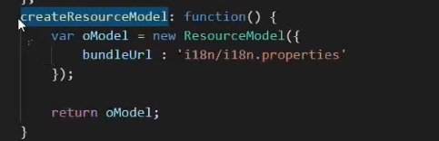
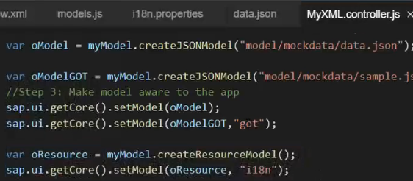
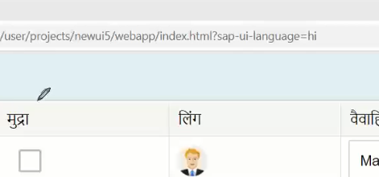
Resource Bundle creation
ResourceModel setting.in view use {i89n>}

Slide 81
Job profile
UI5/Fiori Developers
Language Experts
I18n Bundle
Provide Translation
I18n Model
I18n binding

Slide 82
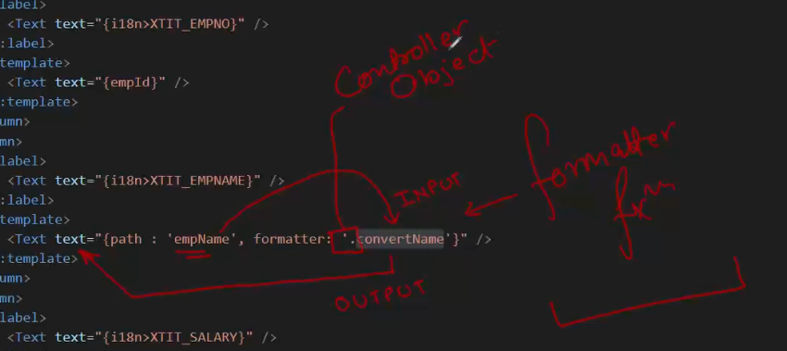
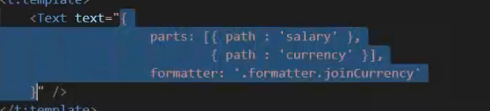
Formatter
Formatter is a function, This function gets called JUST Before the binding takes place with the view.
Model
View
formatter

Slide 83
Use Case

Slide 84
Structure Fiori App
Fiorilikeapp – if an app has Component.js file, its called Fiori Like App.
Mandatory to integrate with Launchpad
index
View
Controller
sap/ui/core/mvc/Controller
sap/ui/core/UIComponent
App.controller.js
Index
CompContainer
View1.controller.js
Component.js
App.view.xml
View1.view.xml
App Container
manifest.json
View2.view.xml
Application Descriptor
View2.controller.js

Slide 85
Component.js
Is a wrapper of all the application functionality of a Fiori Like App. It provides the starting point of our fiori application.
A component.js initializes our application, it has a application descriptor connected to it.
The Component.js must be name it as it is. Should exist in the root directory of our project.
It inherits from standard sap ui5 class “sap/ui/core/UIComponent”
This super class, adds lots of Free benefits to our Component like Router which is the agent for all the application navigation. We need to also initialize the parent class constructor (init) inside the Component.js init.

Slide 86
Exercise
In view 2 implement back button
Mother
App Container Control
A – View 1
M – View 2

Slide 87
List Control
Single Column Table
List
List Header
Item 0
Item 1
Item 2
…
…
…
Aggregation
items

Slide 88
Control Hier. For list
0..n
sap.m.ListBase
items
sap.m.ListItemBase
sap.m.List
DisplayListItem
StandardListItem
CustomListItem
InputListItem
FeedListItem
ActionListItem
ObjectListItem
ColumnListItem

Slide 89
Exercise
Design a json for sample data and email to anubhav on anubhav.abap@gmail.com
JSON will have 3 entities
fruits (15) – name, type, color, availability, price, currency, healthBenefit, unit
Suppliers(10) – company, contactperson, phone, city, sinceWhen, speciality: [“”,””]
Cities(10)- name, state, famousFor, otherName, tierClass, population

Slide 90
Manifest.json
Also known as application descriptor file, it is kept very next to Component.js so Component.js can load it. This file contains sections which describes the entire functionality of our app.
I joined a project where there are 40+ Fiori Apps, each app is different in terms of models, views, controllers, design, usage of controls, etc. Do I need to learn each app by sitting with individual developers? How fast someone can ramp up on a maintenance project?
I developed an app and left for vacation, I get a call from my manager that something is not working, there are other developers who wants to know where have I coded model, view creation, which libs are required to run the app, which versions are required to run this app.
I get so many standard apps with SAP solution like S/4HANA, If I want to learn the inner function of these apps, do I get mobile no. of SAP Labs Developer?
Standardize your development

Slide 91
How to create?
Manifest.json has a fixed format provided by SAP, which will be read by UI5 framework when app starts.
sap.ui , sap.app , sap.ui5
Information of our app like id, name, description, title, version, developer details
About UI5 libraries, required to run this app with versions
Themes supported, devices supported
All the models are kept in manifest to instantiate globally
All the views and navigation is defined in manifest declaratively = Routing configuration
Information about your SAP Backend OData service
Deployment information
Type of app – app. Plugin, extension
Describes the dependencies on other apps
Want to load custom CSS or JS files
https://sapui5.hana.ondemand.com/#/topic/8f93bf2b2b13402e9f035128ce8b495f

Slide 92
exercise
Navigate to next screen when we click on any list item.
Exercise:
add a delete button on top of the list. On click of delete, all the selected items should get deleted.
Select multiple items and click on next icon on top. Show all selected items in list in another list on next screen.
NK to start class on Tuesday explaining why we need the newValue from parameters.
Ravi

Slide 93
Funda Fox
Every Event object has 3 default methods
getSource() which will provide the control object of source control from where event was originated
getParameter() – pass the name of parameter to get its value
getParameters() – read all parameters pertaining to the event
Note: Every event object depending on control type has different parameters.

Slide 94
Worklist App
When an app starts first screen with a list control and on click of a list item, we drill down to details, this standard structure of an app called worklist fiori app
Master Details Fiori App
We need to divide screen into 2 parts, Left section called Master and Right section called Details. When we select a item in left side, the detail will be displayed on the right side.
Split App
Master s
Detail Section
V1
V2

Slide 95
Exercise
When I start app, I want to see an avengers photo on right in a new view. But when user click on one of the fruit, only then show the fruit data on right side.
Whenever we click on one of the supplier in the supplier table, we want to navigate to next view where we only show that single supplier data.

Slide 96
sap.m.Table
SAP Mobile table is a Multi Column List only.

Slide 97
The Enterprise App
We have searched a product on amazon by sorting, searching, filtering after 2 hours, I found a suitable product, I seeing that in my app and suddenly my smartphone battery goes away. I restart my phone after plugin charger. When I reopen app, what should happen, Do I need to spend again 2 hours to get the same product, or should app start from where I left?
When we select multiple products one by one and press back, the app should take us back to most recently selected product.
In an enterprise app, when we see a page, it should have a state. On copy pasting link of that page to another browser window/device, the same state must reload. Bookmarking will work
Anubhav, you taught us creating view objects. But if we have 40 Views, will we write 40X6 = 240 lines to create view objects.
We are creating all the view objects at the beginning itself when app starts, whereas we don’t even know whether user will ever go to that view or not.
What is right place to create view objects. What is the best practice says?
Since new sap.ui.view is deprecated, what is the correct way to create view object?
Turak makto → Router

Slide 98
Router
Router is a object which is provided by SAP as part of UI Component class. It is responsible to not just create our view objects AUTOMATICALLY based on Routing configuration but also takes care of Navigation.
We need to define rootView and routing configuration
Get the router object and initialize the router
Define complete routing addresses to make navigation work
The idea is to make every page/navigation a unique end point so browser can keep track of history automatically.
https://sites.google.com/view/sapfioribatch333/’’
https://sites.google.com/view/sapfioribatch333/my-calendar
https://sites.google.com/view/sapfioribatch333/coursecontent

Slide 99
Exercise
Load the detail of product using router when we click on a product.
Fragments
Fragments are light weight UI parts, these fragments do not have their own controller, they are used to put reusable UI code aside. We can reuse one fragment multiple times, or in multiple views to reuse UI parts. Compare it with sub-screen in dialog programming.
View
fragment
Controller
Button
Button
Button

Slide 100
Use Case
We have a table in our application, our user wants to add
A filter button above the table in a toolbar, when we select the same, a popup should come showing all suppliers with multi-select. On selection, it should filter only those suppliers.
Enable the city column in the table as input field with F4 Help along with a popup. On selection of a city, the selected city will display into the input field.
View
Popup = SelectDialog
Popup
View
View
Fragment
Popup
Popup
View

Slide 101
SAP Fiori System Architecture
Embedded
System
Browser
Fiori
Central HUB Scenario
Browser
Fiori
Application Layer ECC, Suite, BO, BW, BI, S/4HANA, BPC
Build OData Services – GW_FND
SAP Fiori Frontend Server (FES)
GW_FND, Standard Fiori Apps
rfc
Existing ECC/ERP
SAP Fiori Backend System
Fm, Classes, Existing Function
CRM
SRM
Central Hub and Embedded Arch--Gateway Fnd--Both are onprem where we develop Fiori app
To build Fiori app using cloud BTP we will use cloud connector to establish network connection to either Central Hub/Embedded system
HCM
PLM
DB
DB

Slide 102
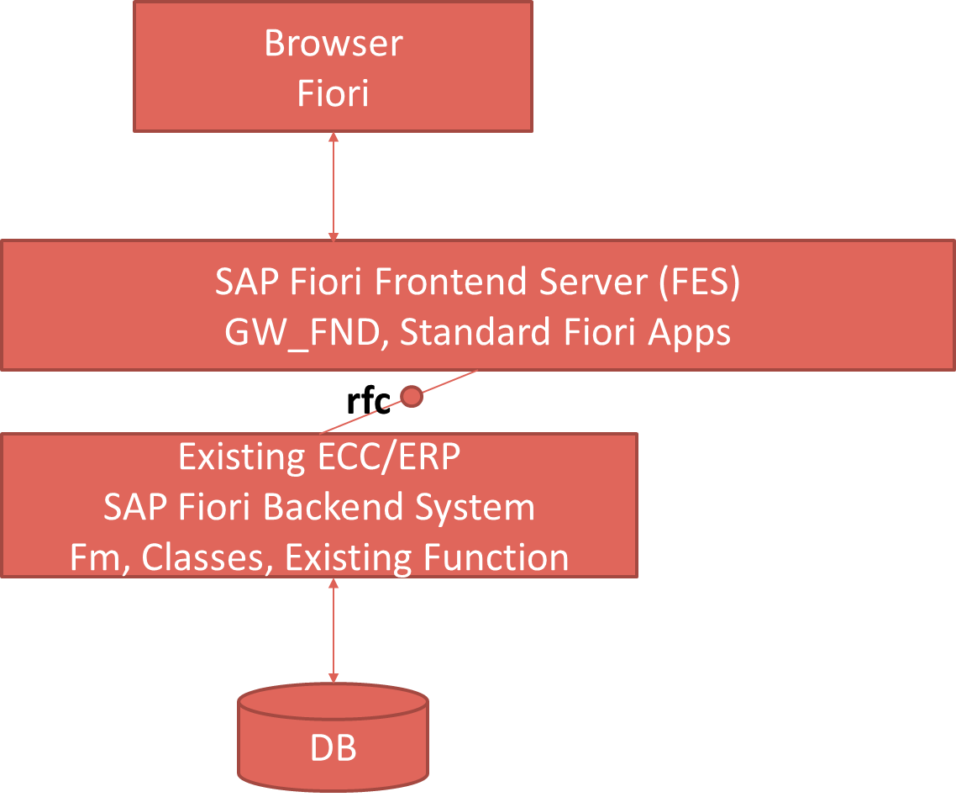
Pros and Cons
Central HUB Deployment
Cons:
Manage multiple systems
Cost is high
Confusion
User needs to be duplicated
OData Metadata is duplicate
Pros
No need to upgrade
Separation of concerns
Works like a HUB
Embedded Deployment (recommended)
Pros – Less Costly, no confusion, No redundancy
Cons – Upgrade
Recommendation
https://www.sap.com/documents/2018/02/f0148939-f27c-0010-82c7-eda71af511fa.html
S/4HANA
CRM

Slide 103
Server Access
Free option – Ask your manager/basis, your co. server
Free ES5 server provided by SAP (Only used for Read)
https://blogs.sap.com/2017/06/16/netweaver-gateway-demo-es5-now-in-beta/
Get server from Anubhav Trainings – 40 USD / 2.5 k INR per month per user EXTRA
Process: Send a email to server@anubhavtrainings.com
All Anubhav’s courses can be practice in this single server (No SU01)
Can connect using your LOCAL SAPGUI/ Local Eclipse
Also get Latest HANA Server Access via Remote Desktop
This is a latest S/4HANA 2002 server
Access to launchpad and Designer
Connect from your personal laptop, NO VPN Required
Anywhere in this world as long as you have internet you can connect to this server
RDP with everything pre-installed
Connect to this server from SAP BTP
Documentation, videos, material for connection

Slide 104
What is OData Service?
OData Stands for Open Data Protocol, it is an OASIS standard to communicate to server using REST based service. It was acquired by Microsoft in 2012 and adopted by many companies to build REST services to expose data over internet HTTP/HTTPs protocol.
Funda Fox
Fiori cannot talk to FM, program, CDS views, …. Fiori only and only talk to OData service which is built on top of FM, ABAP code, CDS view.
Browser
Fiori App
SAPGUI
stateful
stateless
Application layer
Application layer
session

Slide 105
Tcodes and Service
SEGW – SAP Service Gateway Builder
/n/IWFND/MAINT_SERVICE – Register the service
/n/IWFND/GW_CLIENT – gateway client – test locally
/n/IWFND/ERROR_LOG – Check errors, troubleshoot
EPM – Enterprise procurement model – Demo data model given by SAP for Training and demonstration.
ITeIO
SO
PO
Suppliers
Customers
Invoices
Stock

Slide 106
EPM Tables and Service
SNWD_PD – products
SNWD_TEXTS – product texts
SNWD_BPA – Business partner (customers, Suppliers)
SNWD_AD – Address of BP
SNWD_SO – Sales Orders
SNWD_SO_I – Sales Order Items
GWSAMPLE_BASIC – Service
Service Document (Describes the list of EntitySets which are end points for CRUD operations)
http://stcfin.st.com:8021/sap/opu/odata/IWBEP/GWSAMPLE_BASIC/?$format=xml
Service Metadata Document(Describes EntityType – blueprint of the dataset)
http://stcfin.st.com:8021/sap/opu/odata/IWBEP/GWSAMPLE_BASIC/$metadata
Read All in json format – (SELECT * FROM dbtab)
http://stcfin.st.com:8021/sap/opu/odata/IWBEP/GWSAMPLE_BASIC/ProductSet?$format=json
Read Single in JSON – SELECT * FROM dbtab WHERE pk = val
http://stcfin.st.com:8021/sap/opu/odata/IWBEP/GWSAMPLE_BASIC/ProductSet('HT-1000')?$format=json

Slide 107
Operations
Read certain fields – SELECT col1, Col2, Col3 FROM dbtab
http://stcfin.st.com:8021/sap/opu/odata/IWBEP/GWSAMPLE_BASIC/ProductSet?$format=json&$select=Name,Category,SupplierName
Pagination to load data in chunks (SELECT * UP TO ROWS n FROM dbtab)
http://stcfin.st.com:8021/sap/opu/odata/IWBEP/GWSAMPLE_BASIC/ProductSet?$format=json&$top=2&$skip=2
Read data with filter (SELECT * FROM dbtab WHERE condition)
http://stcfin.st.com:8021/sap/opu/odata/IWBEP/GWSAMPLE_BASIC/ProductSet?$format=json&$filter=Category%20eq%20%27Projectors%27
https://services.odata.org/V3/Northwind/Northwind.svc/Products?$format=json&$filter=substringof(%27Spread%27,ProductName)%20eq%20true
Counting Records (SELECT COUNT(*) FROM dbtab)
http://stcfin.st.com:8021/sap/opu/odata/IWBEP/GWSAMPLE_BASIC/ProductSet/$count
Association and Navigation property
Load data of principle and dependent entity in one call (SELECT * FROM tab1 INNER JOIN tab2 ON cond)
http://stcfin.st.com:8021/sap/opu/odata/IWBEP/GWSAMPLE_BASIC/ProductSet('HT-1000')?$format=json&$expand=ToSupplier
Product
Supplier
Order
OrderItems

Slide 108
Connectivity to our SAP Server from Tools
WebIDE
BAS
destination
destination
WebIDE
BAS
SAP Server
destination
Why Destination
To plug and play and connect same project to different system
CORS Cross Origin Resource Sharing

Slide 109
Destination Creation
SMICM
Server Host Name – STCFIN.ST.COM
Port No – 8021 / 44321
WebIDE Destination
Go to WebIDELocalDir\config_master\service.destinations\destinations
Cérate a new notepad file and get the content for the file from official SAP Doc
https://help.sap.com/viewer/825270ffffe74d9f988a0f0066ad59f0/CF/en-US/2cf47f37e34c428c97a51057733c0394.html
3. Sample for you with Anubhav’s system
Description=My new 2021 System
Type=HTTP
TrustAll=true
Authentication=NoAuthentication
Name=S4H
ProxyType=Internet
URL=https\://stcfin.st.com\:44321
WebIDEUsage=odata_abap,odata_gen,dev_abap,ui5_execute_abap,bsp_execute_abap
WebIDESystem=S4H
WebIDEEnabled=true
sap-client=800

Slide 110
Continue…
Make sure we MUST MUST MUST save the file w/o extension
Just Restart Orion.exe
Open SAP WebIDE and choose option Workspace -> Right Click -> Add project from template
Choose a template and proceed with next steps to select the service
We create one destination per client.
Neo-app.json
The file contains the information about destination, which our project should point to
This file is only required while developers are developing apps
That’s why this file is outside webapp folder

Slide 111
<Title>
<Text>

Slide 112
<Title >
Internet
Intranet
SAP On
Premise
BAS
SCC
destination
https://www.youtube.com/watch?v=TFCr16Slhos
https://www.youtube.com/watch?v=Cx3cXAEcnUs
1:15

Slide 113
Reuse The FMs already There in SAP
BAPI_EPM*
Products-
BAPI_EPM_PRODUCT_GET_LIST – Get All Records
BAPI_EPM_PRODUCT_GET_DETAIL – Get Single Record by ID
BAPI_EPM_PRODUCT_CREATE – POST data, Create new Record
BAPI_EPM_PRODUCT_UPDATE – PUT data, Change data
BAPI_EPM_PRODUCT_DELETE – DELETE data
Business Partners
BAPI_EPM_BP_GET_LIST
BAPI_EPM_BP_GET_DETAIL
BAPI_EPM_BP_CREATE
BAPI_EPM_BP_UPDATE
BAPI_EPM_BP_DELETE
GET
CRUD

Slide 114
Runtime Artefacts
MPC and DPC imple are done in backend system and Service registration is done in frontend system in iw_fnd_maint_service which is one time job
MPC
Model provider class
DPC
Data Provider Class
MPC_EXT
Developer writes their custom code
DPC_EXT
Developer writes their custom code CURDQ
Service – PROJECTNAME_SRV
Per method there are 5 methods generated
GET_ENTITYSET, GET_ENTITY, CREATE, UPDATE, DELETE

Slide 115
Service Generation
It is a quick way to generate our metadata and the service code. You should have just basic understanding of DDIC Structure, and the Function modules of your domain.
SNWD_PD table has no data?
SEPM_DG
CSRF Token Handling
https://www.youtube.com/watch?v=Y8-duChsYqI
Read Header data from odata
https://www.youtube.com/watch?v=2mVZsTYIsmY

Slide 116
Associations
Associations are relationships between entities. At DB level we have foreign key relationship and same is reflected @ odata level using association. Once the association is established only then we can create a navigation property.
Product
1 1
Supplier
nav
https://www.youtube.com/watch?v=1tk4DUOXXQw

Slide 117
Function Import
At times, we need to implement the logic inside of OData which is not a direct CRUD operation e.g. calling a workflow, calling a BAPI which does some processing, Sending request to another server…
Find out most expensive product in system
Fiori
ABAP Server (OData)
Data

Slide 118
SAP BAS to On-premise Connection
Pre-requisite
Destination is already configured in SAP BTP
We have a sap cloud connector configured, if it’s a on-prem system
Steps in the project
Enhance manifest.json of the project by adding a new data source, and data model
In the BAS, we don’t have any server running like when we run orion.exe as local WebIDE server. In order to serve all files, we need a built-in service in BTP called html5-repo-rt. We need to include this service to our project. Steps are below
Run a command called npm init which initialize a package.json file
[automatic]We need to add 2 dependencies - @sap/approuter and html5-repo-mock
Before that we need to define Routes, when a call comes from browser to BAS to load Fiori app, how BAS will handle it.
Add 2 dependencies inside devDependencies inside package.json
"@sap/approuter": "^8.6.1",
"@sap/html5-repo-mock": "^1.8.0"
7. We need to run npm install command to now install these dependencies
https://blogs.sap.com/2020/04/03/sap-application-router/

Slide 119
<Title >
<Text>
Client
WebIDE
BAS
Server
approuter
Html-repo-rt
Exercise:
Show the photo of the produ ct below on add screen once the single product is loaded.

Slide 120
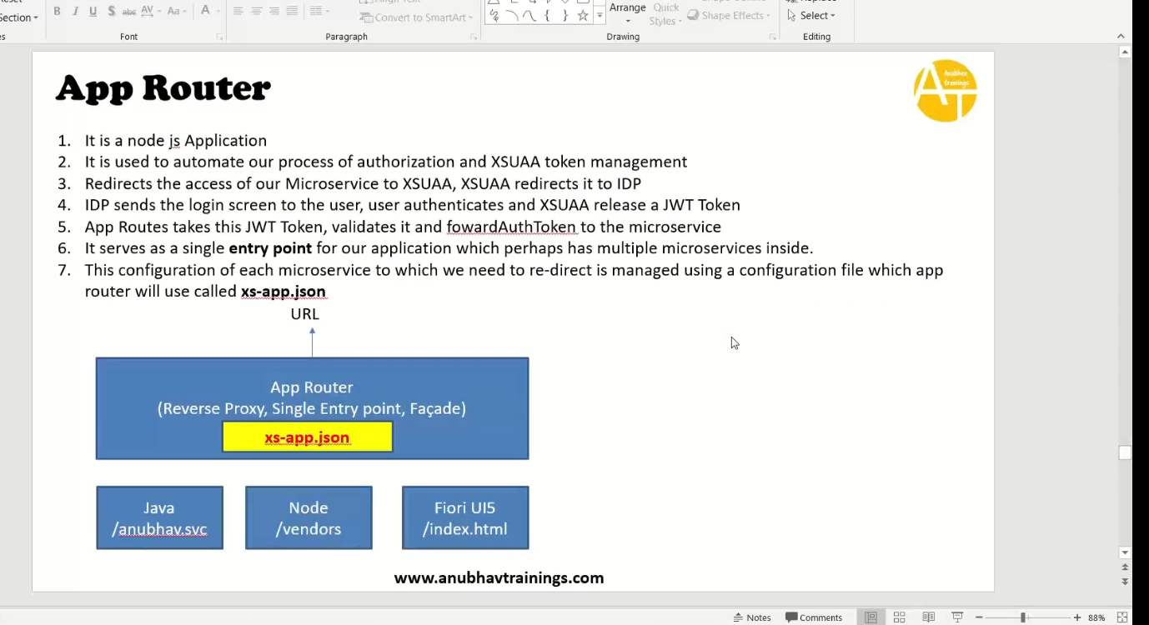
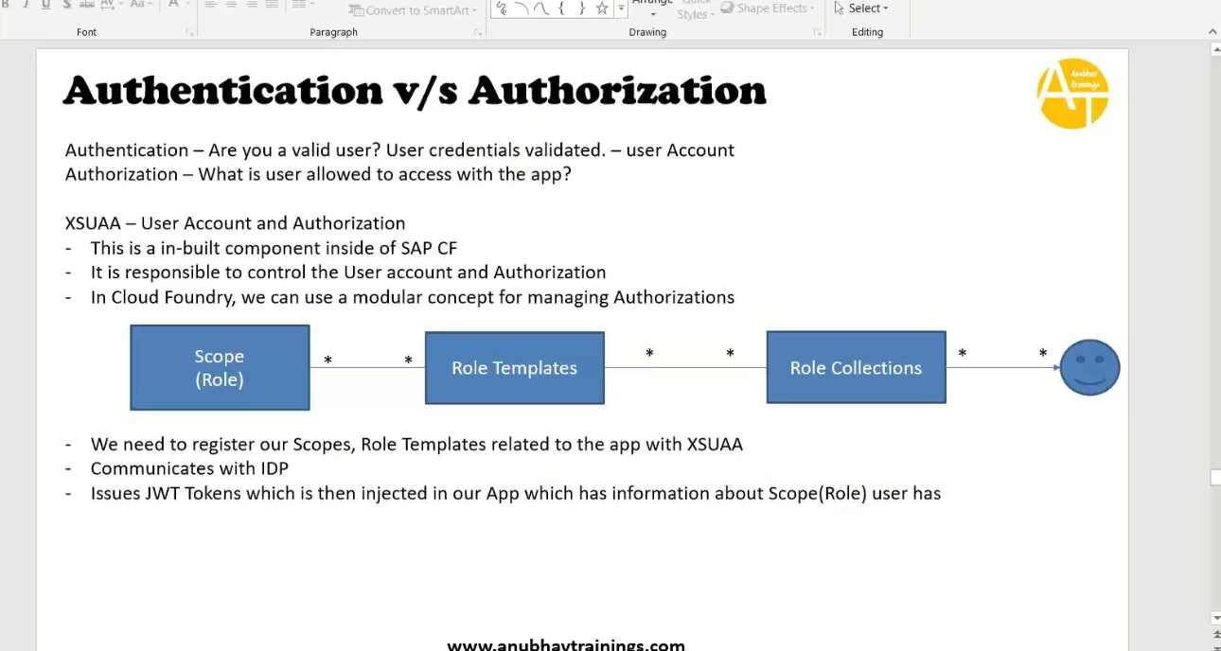
Approuter->Xsuaa->idp(validates user)->xsuaa issues token based on RC to approuter.
JWT return scopes. We will add Role collection(RC) in btp and define role templates and users for it.

Slide 121
Fiori Launchpad
Just imagine, if my co. have developed 500 Apps in last Quarter, These 500 apps have got 500 URLs to access the app. As a end user, you would face below challenges
Finding url for each app is a challenge
Making sure that you are right person to access app – Security
Also you should only be able to see apps which you are allowed to access
SAP Portal is now deprecated, what options do we have to access all functionality of ERP
SAP Fiori Launchpad
Is a single access point for all the Applications in S/4HANA. Is available fiori frontend server once Fiori is installed in your SAP System.
We can configure apps to show all the apps belongs to Standard or Custom Category.
LPD comes with LPD Designer, which allows developer/consultant to configure access to the apps as a Tile. The tcodes are
/n/UI2/FLPD_CONF – Fiori Designer, /N/UI2/FLP – Actual Launchpad (End user)

Slide 122
<Title>
<Text>
Catalog
Tiles(n)
Group
(Ref. tiles)
Role
(Cat+Group)
PFCG
ZBC_MAR_APPS
ZBCG_MAR_APPS
ZBR_MAR_2021
CAProduct-manage

Slide 123
Git HUB
Git HUB

Slide 124
<Title>
<Text>

Slide 125
Thank You
Training | Development | Consulting
The starting point of all achievement is desire. Keep this constantly in mind. Weak desires bring weak results, just like as a small amount of fire makes a small amount of heat.

